Slide 1
Broadcast Technology UG1
Review
Jerry Foss
jeremy.foss@bcu.ac.uk

Slide 2
Learning Outcomes
1. Differentiate between TV audio and video standards and apply for studio applications
2. Evaluate and select data interconnects for audio and video
3. Select and apply test procedures for audio and video signals
4. Compare and contrast network transmission standards worldwide, current and legacy, and evaluate for application to broadcast developments

Slide 3
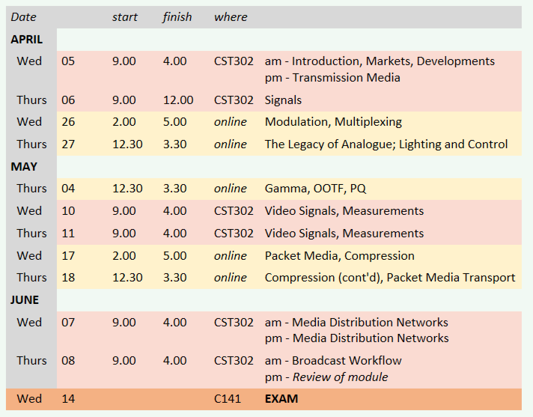
SCHEDULE (Planned)

Slide 4
ASSESSMENT
The assessment for this module will be one exam
(i.e. an exam which accounts for 100% of the final module mark)
Exam date: Wednesday 14th June (morning)
.. online (exam monitoring software)
You are required to answer FOUR of the SIX questions
Questions will have a number of parts (typically 3, 4 or 5)
Marks breakdown is shown in brackets
Each question carries 25 marks; total marks for the paper = 100
Pass Mark: 40%
Note that marks are allocated for method, in addition to the final answer.
Therefore method and full calculations should be shown in your solutions to analytical questions
Calculators may be used provided they are in accordance with Faculty guidelines
Reassessment
Date - tbc
(same format as the original assessment)

Slide 5

Information Transmission, Signal Encoding
Information
Information
Source Information
coded data in as small space as possible (compressed, etc)
Source Coding
Source Decoding
Channel Coding
Channel Decoding
Channel coding
appropriate error protection method
... depends on channel characteristics
modulation on to carrier
bit errors
Modulation
Demodulation
NOISE
signal received – reverse processes
Transmission Link
Crosstalk
Interference
Phase Distortion
Crosstalk
Attenuation
jitter
NOISE
NOISE
transmission is subject to noise interference
aim – to approach the Shannon Limit
jeremy.foss@bcu.ac.uk

Slide 6
Transmission
Media

Slide 7
Transmission Media
Types of Transmission Media
Multiplexing - FDM, TDM, Statistical
* introduction only – will be covered in depth later on
Cables
Twisted Pair
Coaxial
Fibre Optic
Wave Division Multiplexing
Radio
Spectrum
Transmitter
EM Wave, Radio Waves
Propagation through lower and upper atmosphere
Broadcast Transmitter Technologies (valves)

Slide 8
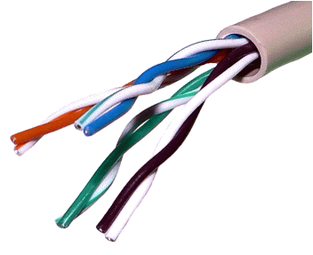
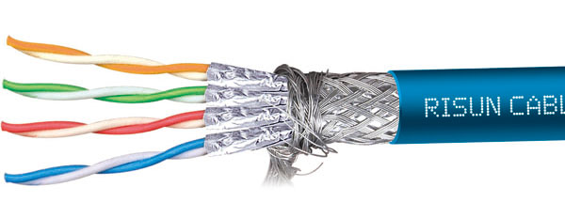
Twisted Pair Cable
Two insulated copper wires that are twisted together (which results in cancellation of induced interference; cancellation of radiated interference, hence reduces radiation)
The individual pairs can be shielded (STP) or unshielded (UTP)
The cable can also be shielded (S/STP)
Categories (CAT ...)
1 - primarily for voice
2 - 4Mbps
3 - 16MHz bandwidth; 10Mb/s
4 - 20MHz bandwidth; 16Mb/s
5 - 100MHz bandwidth; 100Mb/s (4 pairs/cable)
- 400MHz bandwidth; 1Gb/s (4 pairs/cable)
- 600MHz bandwidth (1GHz for Augmented); 10Gb/s
- 1.2GHz bandwidth
Common Uses:
Voice Telephony, various Digital Subscriber Line (xDSL), LANs
CAT 7 – Screen Shielded Twisted Pair (SSTP)

Slide 9
Twisted Pair Cable
Advantages:
High availability
Low installation cost
Disadvantages:
Usable frequency spectrum is small
Limited data rates
Limited range
High suceptibility to electromagnetic and radio frequency interference
ref – Prof. David Bernstein, James Madison University

Slide 10
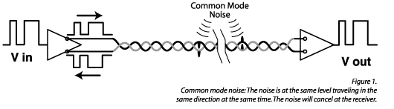
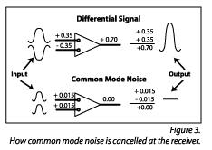
Twisted Pair Cable
In balanced pair operation -
Differential mode transmission -
differential signals; receiver detects the difference between the two
noise signals tend to couple to both wires equally
∴ noise produces a common signal in each conductor
- which is cancelled at the receiver
(not effective when the noise source is close to the signal wires; closer wire will couple with the noise more strongly)
Twist rate
more twists the better (usually)
http://www.extron.com/company/article.aspx?id=utptechnology

Slide 11
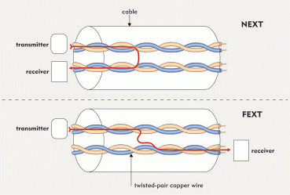
Signal Issues on Twisted Pairs at High Frequencies
Frequency dependent attenuation and dispersion
… Intersymbol Interference (ISI)
Coupling between wires in same and adjacent binders
… crosstalk - near-end cross-talk = NEXT
- far-end cross-talk = FEXT
Bridged taps and gauge transitions
… reflections : pulse distortion (ISI)
Impulsive noise : high bursts of short duration (10 ms - 1 ms)
Impedance mismatch between hybrid and line impedance
… reflections (echo)
RFI interference: AM broadcast & amateur radio
… ingress & egress
All these require a highly adaptive transceiver (at each end)

Slide 12
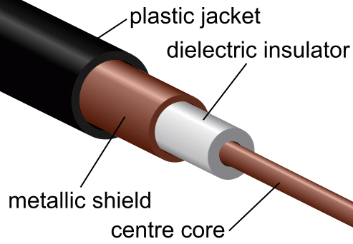
Coaxial Cable
Common Types:
RG-6 - 1.00mm core, 75 Ω
RG-59 - 0.81mm core, 75 Ω
RG-58 - 0.90mm core, 50 Ω
RG-8 - 2.17mm core, 50 Ω
Common Uses:
Applications for RF signals
Cable TV (Old: RG-59; New: RG-6)
Ethernet (RG-58: 10Base2; RG-8: 10Base5)
connecting radio transmitter feeds
A (thick) copper wire surrounded by an insulator and an outer conductor
Advantages:
High capacity (370-1000 times more than twisted pair)
Low susceptibility to noise and crosstalk (because of shielding)
Disadvantages:
Noise on the return path
High installation cost

Slide 13
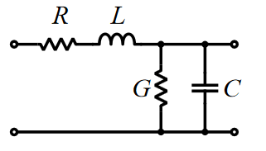
Coaxial Cable
All cables have electrical properties - they are not just short-circuits between equipment
Electrical properties of any cable pair:
R: resistance along the cable
L: signals cause inductance along the length of the cable
G: conductance - a certain amount of leakage, similar to a high resistance between the conductors
C: capacitance between the two conductors
Coax cable is designed to control these parameters

Slide 14
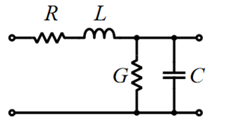
Coaxial Cable
All cables have electrical properties - they are not just short-circuits between equipment
All cables are effectively a (mathematically) complex circuit of distributed impedance sections

Slide 15
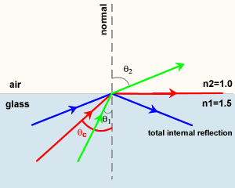
Fibre Optic Cable
Total Internal Reflection
Light passing from one medium (m₁) to another (m₂) with lower index of refraction (ri) bends away from the normal line
At the critical angle, defined by sin ( θ ) = n₁ . n₂, the refracted light will not go into the second medium but will travel along the border

Slide 16
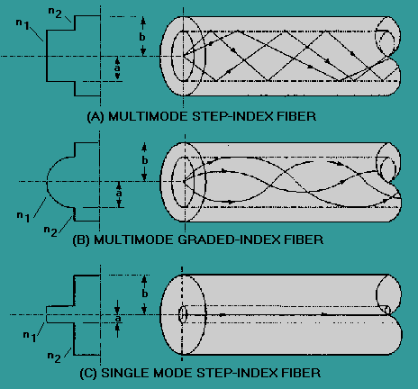
Fibre Optic Cable
Three types of fibre optic cable commonly used:
Multimode - MMF
many rays (modes)
core = 62.5 microns
(some 50 microns)
LED and laser sources 850, 1300nm
LANs
graded index ~2GHz b/w
step index is rare
Single mode - SMF
single ray (mode)
core = 9 microns
telephony, CATV
laser @ 1300, 1550 nm
b/w ~ 100THz

Slide 17
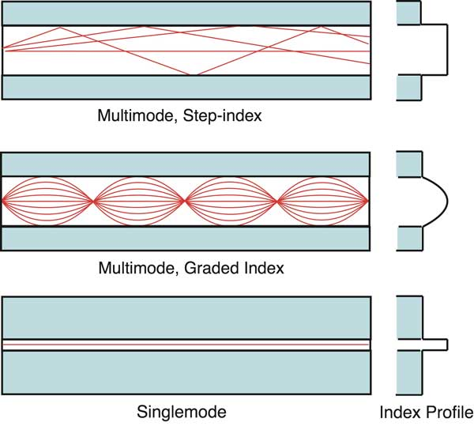
Fibre Optics
Most fibres 125um outside diameter
MMF
larger core: 50 or 62.5um
wavelengths: 850 and 1300 nm
SMF
smaller core ~9um
Plastic Optical Fibre (POF)
large core ~1mm
usually step index
short, low speed
PCS, HCS
PCS plastic clad silica
HCS hard clad silica
smaller glass core ~200um
thin plastic cladding
Summary of Modes and dispersion

Slide 18
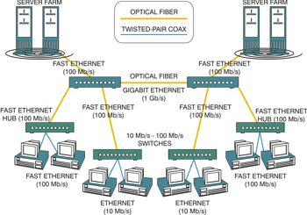
Fibre Networks

Slide 19
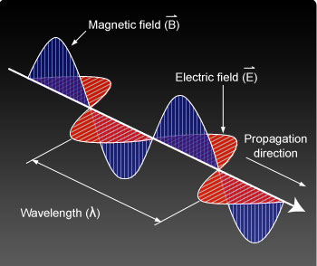
Electromagnetic Wave
alternating electrical current produces an electric and magnetic field that are also alternating
the wave of the electric field and the wave of the magnetic field are propagated perpendicularly to the direction of propagation and to each other
(left) http://learn.uci.edu/oo/getOCWPage.php?course=OC0811004&lesson=005&topic=002&page=21

Slide 20
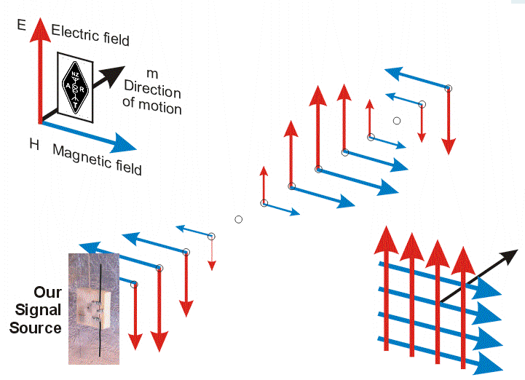
Electromagnetic Wave

Slide 21
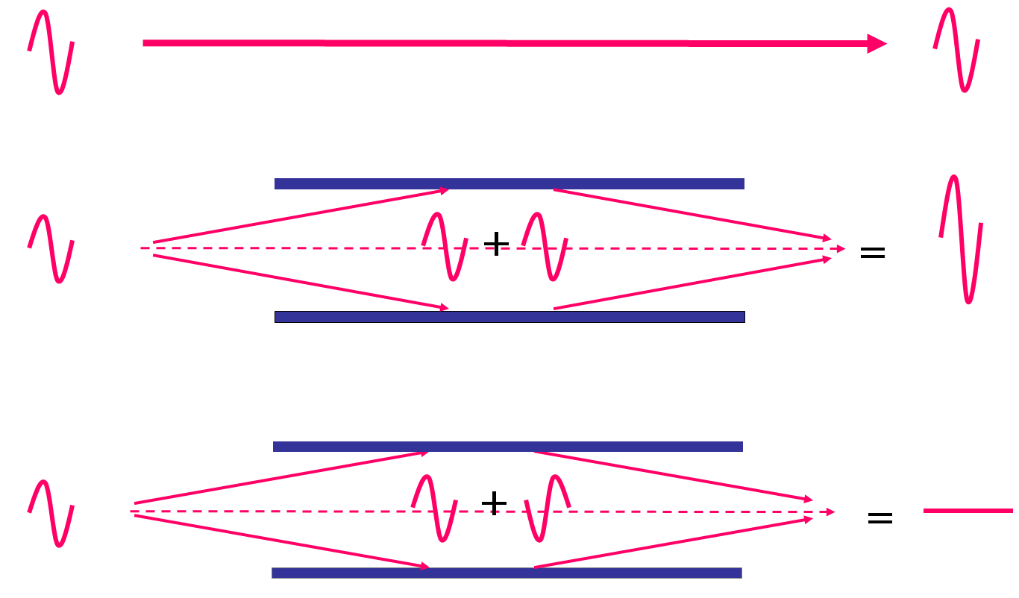
Radio Wave Propagation
Reflection
similar to light
for long wavelengths (80m+)
small obstacles (cars, trees) have little effect
objects small compared to the wavelength, can't reflect the energy
long waves are reflected by the ground ... but also penetrate
short wavelengths - V/UHF waves (2m - 70cm)
very sensitive to small obstacles
metal objects can be used as reflectors
Reflections
e.g. wi-fi in metal framed buildings
radio waves reflect and interact
could cause stronger or weaker reception

Slide 22
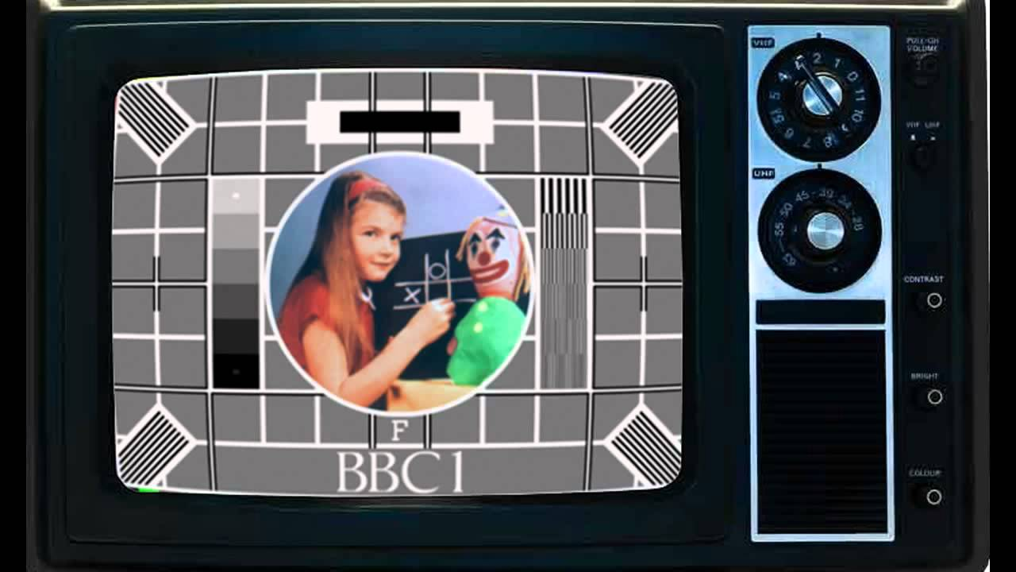

Slide 23
Pulse Transmission,
Interference (ISI)
Eye Diagrams
Original generated signal → transmission system → received signal

Slide 24
Quality of the Transmission
Theoretically perfect random pulse train
Pulse train: two or three pulse periods successively sampled, overlayed on each other
Random pulse train affected by imperfect transmission medias
Practical pulse train: successively sampled, overlayed

Slide 25
Jitter
theroretical clock pulses
actual clock pulses
degraded pulse train received
smearing and delay
overshoot (“ringing” at filters)
Distribution of clocking arising through various issues, e.g. arising through the nodes transmission
pulse train cleaned up at receiver

Slide 26
Eye Diagram - test set-up
Clock In
DATA GENERATOR
CHANNEL
OSCILLOSCOPE
Y-INPUT Ext Trigger
Clock Out
one pulse interval
Sampling Instant

Slide 27
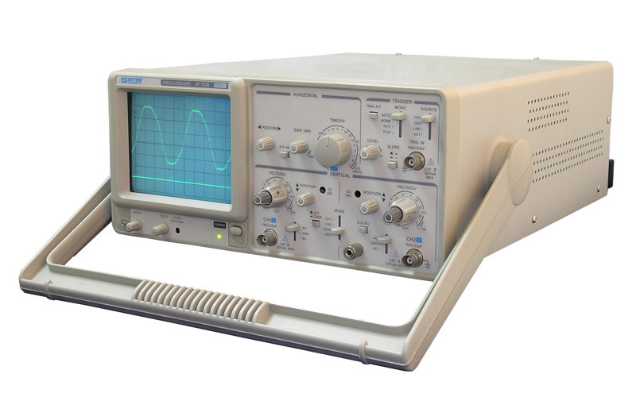
ISI – Eye Diagram
Demonstrated by “eye pattern” analysis of impulse response
It indicates the performance of a transmission system
original generated signal → transmission system → received signal
a run of pulses are fed into a scope –
locked on to one or two pulse widths
superimposed 1’s and 0’s

Slide 28
Different Eye Patterns
Signal only - various small individual random distortions (but likely OK)
- eye is “open”
Signal + timing errors - eye closing
Signal + noise - eye closing (amount depends on noise)

Slide 29
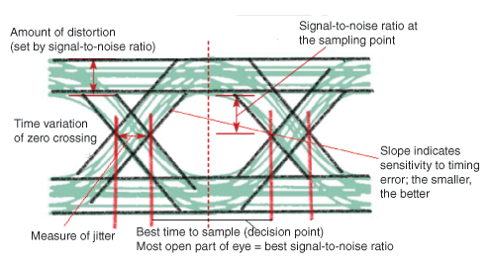
ISI – Eye Diagram
Can reveal important information
best point for sampling
SNR at the sampling point
amount of jitter and distortion
time variation at zero crossing - jitter
http://www.edn.com/design/test-and-measurement/4389368/Eye-Diagram-Basics-Reading-and-applying-eye-diagrams

Slide 30
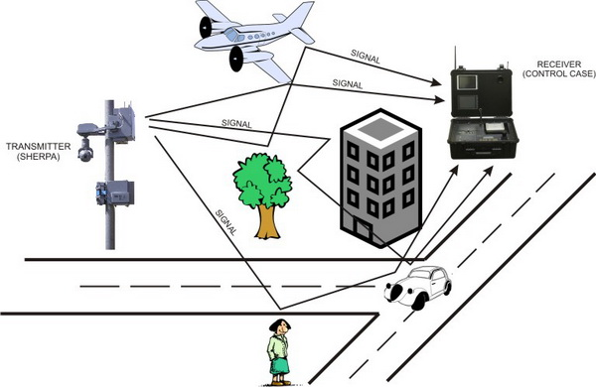
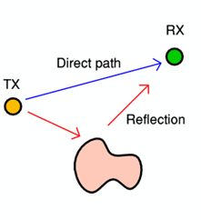
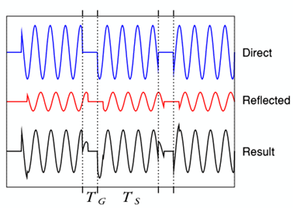
Multipath ISI
an undesirable effect – reflections of radio waves hitting various objects in the environment
unavoidable
http://www.st-andrews.ac.uk/~www_pa/Scots_Guide/RadCom/part19/page3.html
i.e. interference between a symbol and its own reflection … another form of ISI

Slide 31
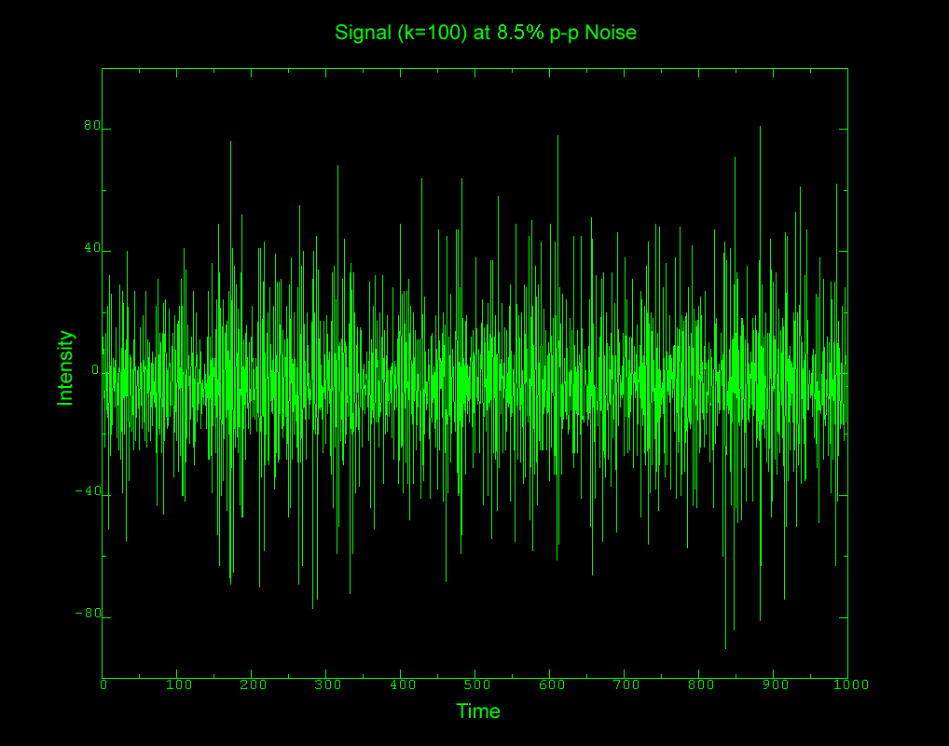
Noise

Slide 32
Noise
IMPORTANCE:
for audio or video:
… noise is an obvious disturbance to the original noiseless signal
for data transfer
… noise can obliterate data; can reduce data rates; require retransmissions, etc

Slide 33
Noise
Nature of noise
typically random – a stochastic process
Noise is manifested as a voltage
… alongside the voltage of the original signal
Various causes of noise
(coming next …)
Need ways to measure and represent noise
signal / noise ratio
Useful noise (sometimes)
white and pink noise

Slide 34
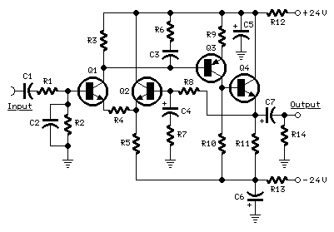
Noise
signal
noise
signal + noise

Slide 35
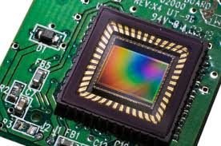

Sensor Noise
any active circuit (and many passive circuits) including camera sensors will produce noise ...
original image = pure grey tone
At the instant of image capture:
+ =
photocell charge plus negative noise spike = darker pixel
recorded image = noisy grey tone
+ =
photocell charge plus positive noise spike = brighter pixel

Slide 36
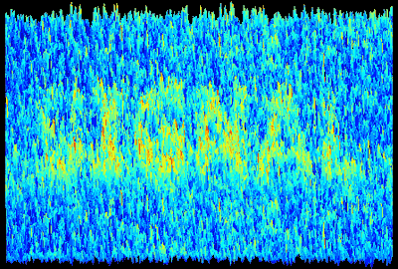
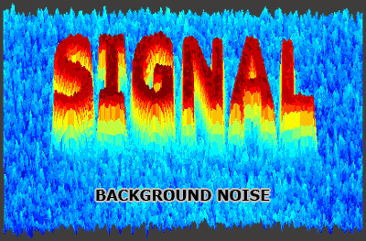
Dynamic Range – Camera Sensor, Signal to Noise
signal: the light which hits the camera sensor
noise is unavoidable
can be small relative to the signal
appears to be nonexistent
signal strength
Signal to noise ratio (SNR)
compare relative amounts of signal and noise
used for any electronic system
image signal
constant noise level
light level
noise low ratio = much noise high ratios = very little visible noise
http://www.cambridgeincolour.com/

Slide 37
Noise Factor, F_{n}
specifies how much additional noise the device will contribute to the noise already from the source.
The noise factor of a system is
the ratio of output noise power (P_{no})
to input noise power (P_{ni}):
Ideally F_{n} = 1
(because noise out would = noise in)
Noise sources are subject to temperature (thermal noise)
∴ needs to be measured at a standard temperature = T₀ = 20ºC; = 293K
F_{n}
F_{n} =
F_{n} =
Noise Figure, NF
Noise Figure NF is the Noise Factor in dB
NF = 10 Log₁₀ F_{n}

Slide 38
Signal Distortion
Frequency Distortion
certain frequencies are boost or cut unevenly across the audio spectrum
stated in equipment specifications as the components frequency response
Phase Distortion
given frequency from a complex waveform takes longer to pass through a signal chain than others: i.e. a phase shift in the individual frequencies
(amplitudes may be amplified equally over the entire frequency band, but the composite waveform has been varied)
Total Harmonic Distortion (THD)
most commonly known form of distortion
directly related to the percentage of harmonics generated by the components in the signal chain
Measured using Fourier Analysis
Intermodulation (IM) Distortion
modulation of combinations of spurious frequencies
the combination of resulting frequencies are equivalent to the sum and/or difference of integral multiples of the individual frequencies of a complex waveform
Transient Intermodulation (TIM)
solid-state amplifiers use negative feedback in order to improve frequency response and reduction of harmonic distortion
occurs during high-frequency music passages

Slide 39
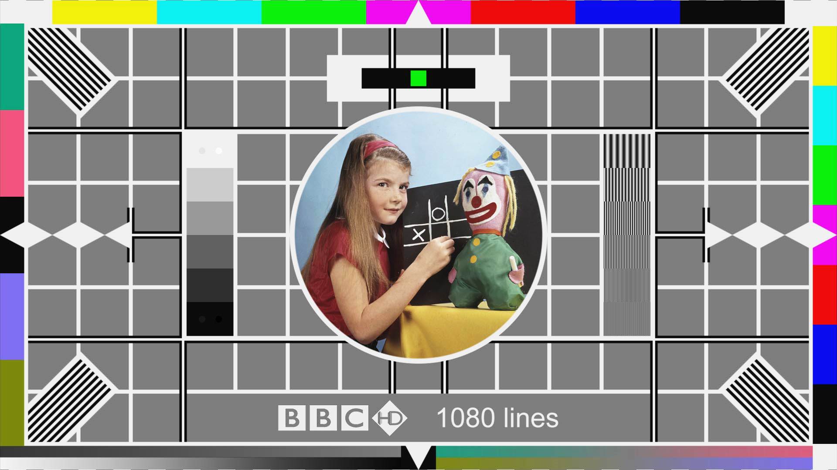

Slide 40
DVB Transmission Playout System
(Based on DVB-T, but –C, -S and –H are similar)
Video Packets
PS
Mux
Audio Packets
TS Mux
Mux adaptation, scrambling
Error Correction
Block Code
Interleaving
(against long errors)
FEC
Convolutional
coding
Data Packets
FEC – Outer …….
FEC – Inner
Interleaving
(against burst errors)
Mapper
(IQ symbols)
Frame adaptation
symbols
Pilot, TPS signals
OFDM
Modulation
Guard interval insertion
DAC for Tx
QPSK, QAM, etc
Blocks (1512 – 6048 sy/block)
of symbols →
frames (68 blocks)
(4frames =superframe)
Transmission parameters
carriers, 2k – 32k (for T2
channel b/w =
1.7 to 10MHz
includes cyclic prefix
Antenna,
Cable,
Sat uplink

Slide 41
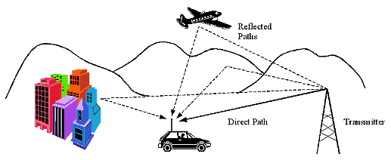
Inter-Symbol Interference for Modulated Data
Causes
In radio:
multipath interference, including atmospherics
On cables:
transmission line propagation, phase delays, electrical characteristics
Implications on radio and cable:
channel gain variations
signal spreading over a transmission line/path
jitter and other timing issues

Slide 42


Multipath Interference in Radio
+ =
+ =
Path difference – results in phase difference

Slide 43
Modulation,
AM, FM, Phase,
(QAM ... later on …)

Slide 44
AM Frequency Spectrum - Sidebands
AM process produces a spectrum containing the carrier and two sidebands of frequencies related to the modulating signal
e.g.:
Power
LSB =
Lower Side Band
USB =
Upper Side Band
f_{c} - freq range of signal
f_{c} + freq range of signal
f_{c}
e.g. modulating signal is between 100Hz and 8KHz,
and carrier freq = 600KHz (=600,000Hz)
Then - USB extends up from [600,000 + 100]Hz to [600,000 + 8,000]Hz
= 600.1KHz up to 608KHz
LSB extends down from [600,000 – 100]Hz to [600,000 – 8,000]Hz
= 599.9KHz down to 592KHz

Slide 45
Subcarriers
An example of subcarrier – consider an AM transmission:
A frequency (i.e. a tone) modulated on to the main carrier
… becomes a subcarrier
Power
Side Band
freq range of signal
f_{c}
This example shows AM modulation on the subcarrier …
but could be other forms of modulation
phase (PM)
frequency (FM)
etc
Power
Data (in sidebands) modulated onto the subcarrier
Side Band
freq range of signal
f_{c}
so, in effect we have two levels of modulation (at least)

Slide 46
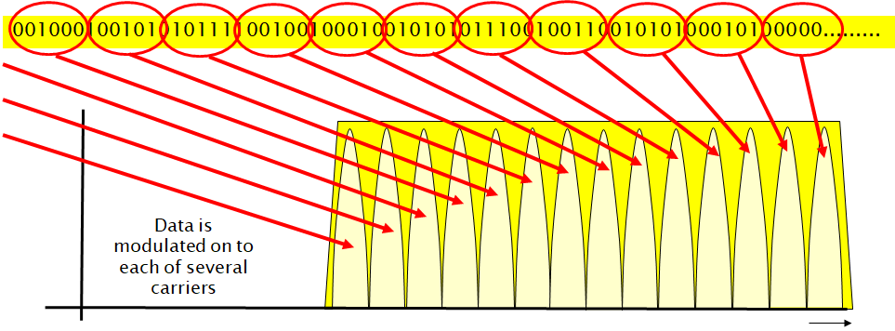
Subcarriers …??
Intersymbol interference due to multipath reflections
Solution: multiple carriers
Total data to be transmitted
freq
But these are separate carriers – not subcarriers modulated onto one carrier
… but they are often referred to as “subcarriers”

Slide 47
PAL Signal Spectrum
Colour Sub-Carrier
(suppressed)
5.68MHz
Chroma coding (QAM)
Vision Carrier
1.25MHz
(AM / VSB)
Sound Centre Freq
6.75MHz
(FM)
freq
7.0MHz
Vestigial Sideband
Full Sideband

Slide 48
Multiplexing:
FDM, TDM
Statistical
Multiplexing: combination of signals to transmit on a common bearer / channel

Slide 49
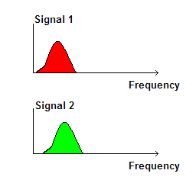
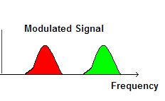
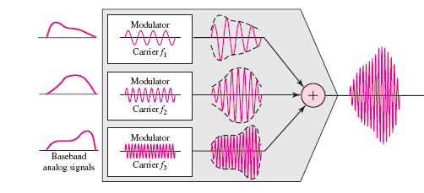
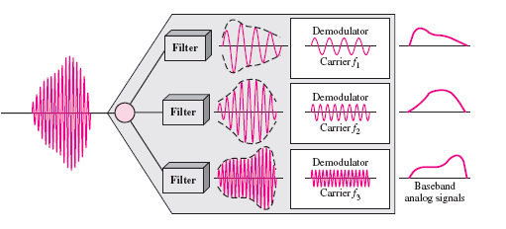
Multiplexing - Frequency Division Multiplexing (FDM)
Each signal is modulated onto a different frequency (subcarrier )
“baseband”
signals
i.e. unmodulated original signal
f₁ f₂

Slide 50
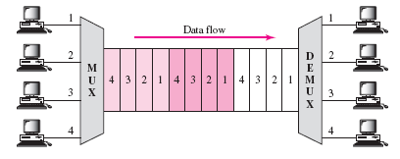
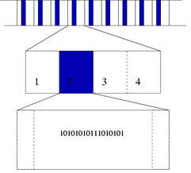
Multiplexing - Time Division Multiplexing (TDM)
Multiple signals are interleaved (in bits or blocks) over time
Data streams divided into frames
Frames divided into time slots
Each user is allocated one time slot
Time slots contain data with guard period if needed for synchronisation
2
1
3
4

Slide 51
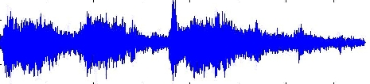
Time Division Multiplex
4kHz voice sampled at 8kHz (fs) into 8 bits binary
Analogue – Digital: Samples are dropped into allocated timeslot for each frame
TS6 next frame
TS6 previous frame
TS6 this frame
010100101
010100101
01001001
10010001
10110011
010100101
10010001
01001001
010100101
010100101
01001001
TS1 TS2 TS3 TS4 TS5 TS6 TS7 TS8 ………………………………………………………………….
e.g. for UK / European E1 Multiplexes:
30 channels of speech into 32 channel frame “Multiplex”
32 channels x 8b x 8kHz = 2.048Mbs-1
(includes 1 channel signalling and 1 channel synchronisation)

Slide 52
Multiplexing - Statistical Multiplexing
Statistical Multiplexer
Source A
Source B
Source C
Source D
Source E
Input buffer
Input buffer
Input buffer
Output buffer
Outgoing Port:
Packets are placed on the outgoing channel
Input buffer
Input buffer
Incoming ports: Data blocks arrive asynchronously from variable-rate sources
Input buffers smooth fluctuation in input data rates
Headers containing addresses and other information are added to the data blocks – to form packets
Packets are then fed to the output buffer

Slide 53
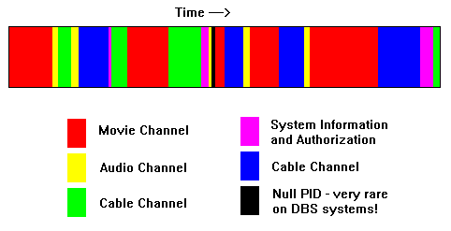
Multiplexing - Statistical Multiplexing
e.g. DVB multiplex:
Packet format: Control, management and content assigned into fields
Start
Flag
Address
Field
Control
Field
Information
Payload
Error
Control
End
Flag

Slide 54
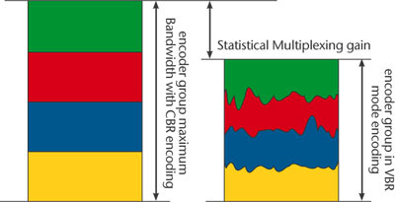
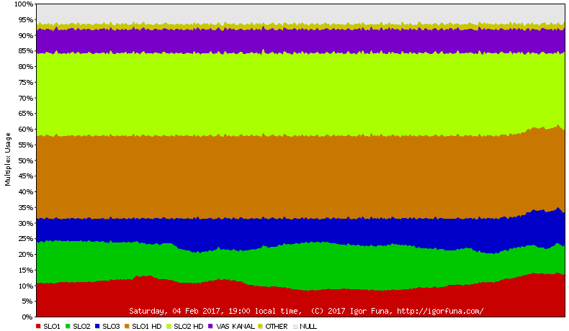
Statistical Multiplexing
Dynamic capacity allocation
Variable Bit Rate – VBR
one channel capacity reallocated to meet immediate service needs of other channels
allow additional elementary bit streams to be added at the input of the multiplexer
... or allow elementary bit streams to be multiplexed at a second stage
http://igorfuna.com/dvb-t/slovenia/multiplex-a-usage-chart

Slide 55

Correction to a Power-Based Curve
(Simplistic explanation):
Input is raised to a power $1/$ɣ
V_{file} = V_{in}^{1/ɣ}
And output (display must be inverse of this, ɣ:
V_{display} = V_{in}^{ɣ}
Actually, the equations may include a system constant A:
V_{file} = AV_{in}^{1/ɣ}
(where A = a constant)
V_{display} = AV_{in}^{ɣ}
Result:
The eye needs to see the result of the
input ⇨ output transfer
… and should be a straight line
i.e. the viewer sees the original scene
Brightness / Intensity of image/Display
Exposure of scene

Slide 56
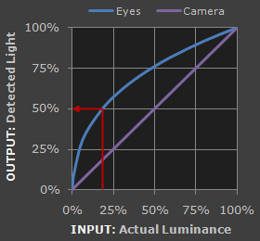
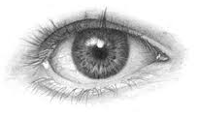
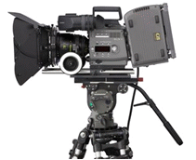



Eye Response Compared to Camera ... Gamma (ɣ)
Camera response is linear ...
Eyes are much more sensitive to changes in dark tones than we are to similar changes in bright tones
… this enables our vision to operate over a broader range of luminance
(otherwise - outdoors brightness ranges would be too overwhelming)
Reference Tone
(full brightness)
Camera detects this as 50% as bright
Eyes detect this as 50% as bright
http://www.cambridgeincolour.com/tutorials/gamma-correction.htm

Slide 57
Eye Response Compared to Camera ... Gamma (ɣ)
Gamma translates between our eye's light sensitivity and that of the camera
when a digital image is saved, it's gamma encoded
the file more closely corresponds to what we would perceive in brightness increases
Reference Tone
(full brightness)
Camera detects this as 50% as bright
Eyes detect this as 50% as bright
http://www.cambridgeincolour.com/tutorials/gamma-correction.htm

Slide 58
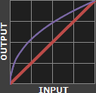
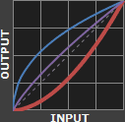
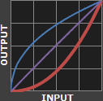
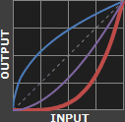




Display Gamma
display gamma over-compensates for the image gamma
overall system gamma that curves downward
(darkens the image)
display gamma exactly corrects the image gamma
overall linear system gamma
✓
x
x
x
Display Gamma 1.0 1.8 2.2 4.0

Slide 59
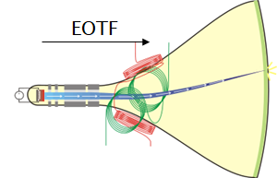
HDR Transfer Functions
Ideally EOTF should be defined by the human visual response
The current gamma worked well enough for the CRT era
… is a sort of perceptual EOTF
… But only at relatively low luminance levels
and small dynamic ranges
But next generation systems
are much brighter
have much higher dynamic range
… so need to stretch or modify gamma to allow a little more brightness and dynamic range out the current system
… and adapt to scenes

Slide 60
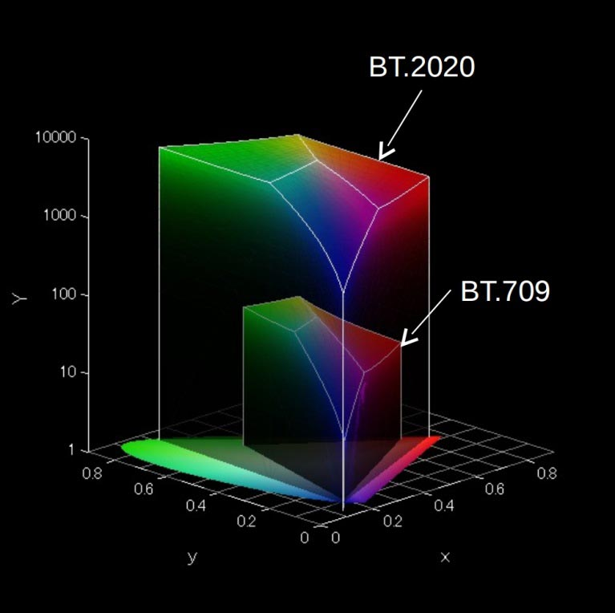
Colour in BT.709 vs BT.2020
Colour/luminance volume:
BT.2020 (10,000 nits for new LCDs and OLED displays)
vs
BT.709 (100 nits); Yxy
(Sony)
Nit: Unit of luminance, the intensity of visible light.
To describe the brightness of TV displays.
One nit = one candela/m²
https://www.flatpanelshd.com/focus.php?subaction=showfull&id=1505390780

Slide 61
The Need for HDR Transfer Functions – HLG and PQ
Traditional display devices
used BT.709 Gamma transfer function
brightness range of up to 100 Nits (cd/m2).
For HDR
Perceptual Quantizer (PQ)
an absolute, display-referred signal
(i.e. image data is referred to each display’s capabilities)
implement tone mapping to adapt the light levels
use content metadata to display PQ coded images
could be for entire video stream (static)
or for each individual shot (dynamic)
but dynamic PQ not compatible with existing display systems
Hybrid Log-Gamma (HLG) - a relative, scene-referred signal
compatible with existing display systems

Slide 62

HDR – Signal To Light Mapping
Brightest
Image
BT.709 Gamma
HLG
PQ SMPTE ST2048
Darkest
Image
light level range in darker region is represented by a larger signal value range compared to the brighter regions: so more granular representation in darker regions
this is more evenly distributed for the BT.709 based displays
become less granular for HDR displays in the brighter regions

Slide 63
MPEG Systems
Data
MPEG-2 Transport Mux
MPEG-2
Compressors
Video
Audio
Video
Audio
Transport Stream, TS
Decoder
MPEG-2
Systems Processor
MPEG-2
Systems Processor
Decoder
Program Stream, PS
Decoder
Requirement:
To transmit Audio and Video compressed data in:
(i) reliable channels – studio, DVD, reliable media (PS)
(ii) transmission in hostile environments (TS)
Allow interchange between these two formats

Slide 64
MPEG-2 Packets and Multiplexes
audio and video data can be exchanged between TS and PS at PES level
Access Units (AU)
Audio Elementary Stream
Audio Presentation Units: 24mS of Raw uncompressed audio
Audio PES
Audio
Encoder
TS Multiplexer
Transport Stream
(TS)
Packetiser
Clock
Video
Encoder
Packetiser
PS Multiplexer
Program Stream
(PS)
Video Presentation Units: Raw video coding at discrete time intervals
Video PES
Scope of MPEG-2 Systems Standard
Access Units (AU)
Video Elementary Stream

Slide 65
MPEG-2 – PES ⇒ PS Packs and TS Packets
PS
Pack
Pack
........................
Pack
Pack
Program end code
Pack
Pack
Header
PES
PES
...................
PES
PES
PES
PES
Header
PES payload
TS
Packet
TS
Header
TS payload
TS
Header
TS payload
TS
TS Packet
PID =m
TS Packet
PID = k
TS Packet
PID = m
.................................
TS Packet
PID = h
TS Packet
PID = k
188 bytes
188 bytes
188 bytes
188 bytes
188 bytes

Slide 66
MPEG-2 – PES ⇒ PS Packs and TS Packets
PS
Pack
Pack
........................
Pack
Pack
Program end code
Pack
Pack
Header
PES
PES
...................
PES
PES
PES
PES
Header
PES payload
Program Steam - PS
for transmission and storage in error-free channels
PES - long variable-length packets
... into variable length packs
multiple PES packets
... of nearly equal length
(video and audio)
TS
Packet
TS

Slide 67
MPEG-2 – PES ⇒ PS Packs and TS Packets
PS
Transport Stream – TS
for channels with likely errors
short fixed-length: 188B
PES packets – long variable length
Sub-divided
carried as payload of TS packets
Pack
PES
PES
Header
PES payload
TS
Packet
TS
Header
TS payload
TS
Header
TS payload
TS
TS Packet
PID =m
TS Packet
PID = k
TS Packet
PID = m
.................................
TS Packet
PID = h
TS Packet
PID = k
188 bytes
188 bytes
188 bytes
188 bytes
188 bytes

Slide 68
Video Compression (Introduction)

Slide 69


The Eye
The Eye
The Eye

Slide 70


Psychovisual – how we perceive images
Light sensitivity in the eye
Rods - light intensity - not colour
~125 million across the retina
characteristics of high speed black & white film
Cones - colour - responsive in three wavebands
6 or 7 million cones
characteristics of low-speed colour film
RODS and CONES
(retina)
... Chroma Sub-sampling

Slide 71

Images Captured on a Camera
Original captured image at camera sensor:
Image captured on red blue and green – responsive photo-sites
each pixel is represented by R, B, G
each pixel has its own value of light intensity

Slide 72
RGB to Y,Cb,Cr
Y
During the encoding stage ...
Cb
RGB pixel format … … … is converted to … … … Y,Cb,Cr
where
Y = luminance (light intensity)
Cb, Cr = colour information
Cr
Weighted RGB converted to Y Cb, Cr
0.2989*R + 0.5870*G + 0.1140*B

Slide 73


RGB to Y,Cb,Cr – each pixel
Overall luminance
i.e. greyscale, monochrome
of this pixel
= Y, ... i.e. the luma
Weighted RGB luminance:
approx 29% Red + 59% Green + 11% Blue

Slide 74
RGB to Y,Cb,Cr – each pixel
Cb = B – Y
i.e. 8 bits of Cb (0-255)
value of Cb:
value of original Blue
minus
value of luma
= -
e.g.
= 210 - 90
1111000
11010010
similarly,
Cr = R – Y
= -
01011010
Overall luminance
i.e. greyscale, monochrome
of this pixel
= Y, ... i.e. the luma
Weighted RGB luminance:
approx 29% Red + 59% Green + 11% Blue

Slide 75
Y,Cb,Cr – for image of x x y pixels in “4:4:4”
y pixels
x pixels

Slide 76
Y,Cb,Cr – Chroma Sub-sampled to “4:1:1”
y pixels
Reason: To greatly reduce the amount of data
Rationale: The eye’s resolution of luminance is greater than for colour
x pixels

Slide 77

Y,Cb,Cr
Original image
YCbCr
Colour Space: Y = Luminence Information; Cr, Cb = Chrominance Information
Derived from RGB (gamma corrected)
Y is dominant information; RGB colour info derived from Y, Cr, Cb relationships
(simplified): Cb = B-Y ; Cr = R-Y
Y
Cb
Cr

Slide 78




RGB to Y,Cr,Cb
i.e. there are now three mappings of the original RGB image:
Y: Luminance intensity
Cb: Intensity of the values of
[B minus Y]
Cr: Intensity of the values of
[R minus Y]
Y
Y
Cb
Cb
Cr
Cr

Slide 79



Reception / Decoding
encoding process
decoding process
Decoding, reverse process ...
from Chroma sub-sampled to full RGB
note – interpolating lost information
∴ detail is lost in the process
Perceptual (e.g. MPEG, etc ) encoding + decoding is also part of this process and loses a lot more detail
... more later in the module

Slide 80
Contribution and
Distribution

Slide 81

Contribution and Distribution
Production Contribution Distribution Consumption
http://www.cisco.com/c/en/us/solutions/service-provider/distribution/index.html#

Slide 82


Broadcast and Production Workflow (BBC Schematic)
Transmission
Low end /
Domestic
Camcorders /
DSLRs
Edit
PRODUCTION
Effects
Grading
CODING
&
MULTIPLEX
Audio
Dubbing
News
Camcorders
Graphics
SCHEDULE
CREATION
Hi-End
Camcorders
Data
Input
AUTOMATION
& PLAYOUT
EPG
CREATION
Digital
Cinema
Cameras +
Recorders
ACQUISITION
LOGGING
INGEST
MEDIA
STORE
DELIVERY
Multi-
Camera
Studio / OB
Data Store
Database
Streaming
Encoding
Live Feeds
Studios
OBs
Other
Material
iPlayer
Website
Data
Input
CDN
INTERNET
ARCHIVE
Media
Metadata
Both

Slide 83

Workflow Processes
Typical – there are many variations ...
... and automated:
http://www.snellgroup.com/documents/brochures/automation-and-media-management/Momentum.pdf

Slide 84

MEDIA ASSET MANAGEMENT
Database
BPM: Business Process Management (“Workflow Engine”)

Slide 85




Typical MAM File System Approach
Preferred approach - file-folder structure
accessible via a standard network protocol (rather than a proprietary interface between the storage and the asset management system)
File 1: DISK H1 … written today
File 2: LTO L3
File 3: DISK H4 … being copied to LTO L2
File 4: LTO L2
File 5: DISK H3 … written last hour
File 1: LTO L7
File 2: LTO L5
File 3: DISK H2
File 4: LTO L1 being copied back to disk (due to recent read attempt)
+ access to other cloud storages (own, third party)

Slide 86


Linear Tape Open – to LTO 10
General specifications
Tape type | Raw capacity (compressed capacity @ 2.5:1) | Max Uncompressed Speed MB/s (note bytes) | WORM | Released
LTO-1 | 100 GB | 20 | No | 2000
LTO-2 | 200 GB | 40 | No | 2003
LTO-3 | 400 GB | 80 | Yes | 2005
LTO-4 | 800 GB | 120 | Yes | 2007
LTO-5 | 1.5 TB | 140 | Yes | 2010
LTO-6 | 2.5 TB 6.25 TB | 160 | Yes | 2012
LTO-7 | 6.4 TB 16 TB | 315 | Yes | 2015
LTO-8 | 12.0 TB 30 TB | 472 (upto 900Mb/s) | Yes | Now
LTO-9 | 26 TB 65.2 TB | 708 | Planned | TBA
LTO-10 | 48 TB 120 TB | 1100 | Planned | TBA
(2014 … )
Sony Tape @ 148Gb/in2
… 185TB per cartridge
Note comparative native / compressed capacities

Slide 87
IP Workflows
SMPTE 2022, 2110

Slide 88
IP Workflows
Why IP is replacing SDI*
Universal connectivity (broadcast and other industries)
Lower budgets, higher quality requirements
Production companies scaling:
IP allows best production talent remains in a central location
Receive camera feeds from remote locations
Democratise the industry
single producer can have many camera inputs from anywhere in the world
* although SDI is still in development

Slide 89
How is IP Television Routing Different from SDI ?
In SDI Routing, all routing in the SDI crosspoint frame
The Control System tells the crosspointwhat to switch where
The Crosspoint Router switches everything internally
Receivers just receive all data sent to them
In IP Routing, the Receiver is involved …
Control System tells the Receiver:
What Multicast Group & Port# to switch to (Main and Protect)
Technical Metadata of the new stream
The Receiver is responsible for how it switches/transitions to it
The Receiver asks the network for the new signal
The network provides the new signal through packet forwarding logic
https://www.smpte.org/sites/default/files/section-files/GVExpo2018%20SMPTE%2004%20-%20Scalable%20Facilities%20with%20ST%202110%20-%20Mailhot.pdf

Slide 90


Traditional Broadcast and Media Routing
Slide from Phil Myers, Snell Advanced Media, SMPTE presentation, BCU. 2017

Slide 91

IP World of Broadcast and Media Routing
Slide from Phil Myers, Snell Advanced Media, SMPTE presentation, BCU. 2017

Slide 92

SMPTE ST 2022-6 (Multiplexed Streams)
Slide from Phil Myers, Snell Advanced Media, SMPTE presentation, BCU. 2017

Slide 93

SMPTE ST 2110 – Essence Streams
Slide from Phil Myers, Snell Advanced Media, SMPTE presentation, BCU. 2017

Slide 94
Content Delivery Networks

Slide 95

Content Networking
Internet - end-to-end
core network is simple - only forwards data packets
intelligence is at edges
1 – central server
2 – cache (edge server/cache)
3 – end users
CDN - to optimize content delivery
infrastructure solutions to network service providers who deploy their own dedicated digital media delivery
asset tracking
network performance
real-time load
statistics reporting

Slide 96
Content Networking
system of caches containing copies of data
data is distributed at various points in a network
maximizes the bandwidth required to access the data from clients throughout the network
1 – central server
2 – cache (edge server/cache)
3 – end users

Slide 97





The Cloud
Not really a cloud (!)
a facility of servers and processors
may be private owned
may be third party owned
resources rented out
service level agreements
Storage
Processing
Software as a Service (SaaS)
Platform as a Service (PaaS)
e.g.
media workflow facilities
video headends
etc …

Slide 98




Media Distribution
Video Head-End
VOD and
Various
Functions
(Servers, etc)
Distribution Network
Satellite
Cable
Telco Broadband
Terrestrial TV
Web (OTT)
Mobile
End Users
Access to
WWW
Telephone N/W
Ingest of Media
STB, etc
Network Access Equipment

Slide 99

Media Distribution ... ... Satellite
Video Head-End
VOD and
Various
Functions
(Servers, etc)
End Users
Access to
WWW
Telephone N/W
Ingest of Media
STB, etc
Network Access Equipment

Slide 100

Media Distribution - Digital Terrestrial (DTTV)
Video Head-End
VOD and
Various
Functions
(Servers, etc)
End Users
Access to
WWW
Telephone N/W
Ingest of Media
STB, etc

Slide 101
Media Distribution – Cable
Video Head-End
VOD and
Various
Functions
(Servers, etc)
Cable Network
Network Managed and Operated by Network Provider / Operator
- Routing, Switching, etc
End Users
Access Network
Access to
WWW
Telephone N/W
Ingest of Media
STB, etc
Network Access Equipment

Slide 102
Media Distribution – IPTV - Telco Broadband, OTT/Web
Video Head-End
Telco Broadband
VOD and
Various
Functions
(Servers, etc)
Network Core
Network Managed and Operated by Network Provider / Operator
- Routing, Switching, etc
End Users
Access Network
Access to
WWW
Telephone N/W
Ingest of Media
STB, etc
Network Access Equipment

Slide 103
Media Distribution – IPTV - Telco Broadband, OTT/Web
Video Head-End
Telco Broadband
VOD and
Various
Functions
(Servers, etc)
OTT
Network Core
Network Managed and Operated by Network Provider / Operator
- Routing, Switching, etc
End Users
Access Network
Access to
WWW
Telephone N/W
Ingest of Media
OTT
STB, etc
WEB-BASED VIDEO PROVIDER
Network Access Equipment

Slide 104
Media Distribution
Broadcast
but what is “broadcast?”
… vs On Demand
(what are “video servers”? – or any other server)
digital cinema distribution
Streaming:
DVB – Cable, Satellite, DTTV
IP-based – IPTV (Telco broadband, OTT)
http
MPEG → DASH (dynamic adaptive streaming on http)
HLS (http live streaming, Apple implemented)
rtp protocol

Slide 105
The Headend (Cable, Satellite, Web, Telco ... )
Video Head-End
Off air
Content
Encoding /
Transcoding
Multiplexing
Prepare for
Transmission
modulation, etc
VOD and
Various
Functions
(Servers, etc)
Local
Content
Transmission
Network
cable
satellite
Telco IPTV
Web
Conditional
Access
End Users
EPG
Middleware
Advertisment Inserts
Customer
Home
Modem
Set Top Box
inc CA
TV
Authentication
STB, etc
DHCP
Network Access Equipment
Additional Services

Slide 106
Streaming
HTTP, HLS
MPEG-DASH
RTP/RTSP

Slide 107
HTTP Streaming
The original solution for streaming
... overtaken by RTP/RTSP based for large IPTV deployments
... more recently back in favour
used generic HTTP servers (often based on Apache or Windows Server)
Early days
Limited bandwidth available
“Download and play”
no lookahead seeking or random access
Multiple viewers – server bandwidth issues
Apple introduce progressive download

Slide 108
Streaming Media Protocols – HTTP addresses RTMP Issues
HTTP server/client – stateless
HTTP-streaming: retrieves consecutive short chunks on as-needed basis
little waste (the video is delivered as it is watched)
server efficiently serves more streams
Random seeking
(viewer selects – player retrieves the appropriate chunks)
firewall friendly
can utilise HTTP caching mechanisms
less expensive to implement (no streaming server required)
scale more cheaply and effectively to serve available users
RTMP/RTSP/HTTP – state of the market
little impetus for RTMP/RTSP sites to change –still widely used
new installations - overwhelming view – HTTP
in fact most video content is delivered via plain old HTTP progressive download

Slide 109
HTTP Streaming
Segment timing:
10 seconds = reasonable balance for most broadcast content
Shorter segments
= more frequent refreshes of the index file
.. unnecessary network overhead for the client
Longer segments
= latency and initial startup time
Media Formats
e.g. video: H.264 / VP9,
audio: .aac / Opus, etc
video + audio file segments unwrapped
… but certain applications –
can be wrapped in MPEG-TS (DVB)
Client
Server
http GET
Audio segment
http GET
Video segment
etc

Slide 110

HTTP Live Streaming - HLS
Apple (part of QuickTime and iOS)
HLS v5 announced in Sept16
support for Fragmented MP4

Slide 111

MPEG-DASH
Dynamic Adaptive Streaming over HTTP
Background
(commercial) audio/video was typically transported over RTP/UDP
(but streaming proprietary solutions based HTTP/TCP)
HTTP streaming - good - provided that the increased latency is acceptable
Benefits:
Firewall and NAT traversal (c.f. services based on RTP/UDP)
Widely deployed network caches (CDNs)
Deployment of CDN caches can be kept simple
Complexity (adaptation) moved to client
Servers are agnostic to delivered content
network resources / configuration may vary over time
http://www.streamingmedia.com/Articles/ReadArticle.aspx?ArticleID=79041

Slide 112

MPEG-DASH
DASH client obtains the MPD …
MPD (Media Presentation Description) –
XML document
delivered using HTTP or other transport
describes media data available at the servers
allows clients to select the data
defines segments available
can either be
initialization segments - initialization data for decoding
media segments
segment format based on MPEG2-TS
Using ISO base Media File Format (ISOBMFF - general structure for time-based media
(however, segments based on other formats can be specified)

